Slide 1
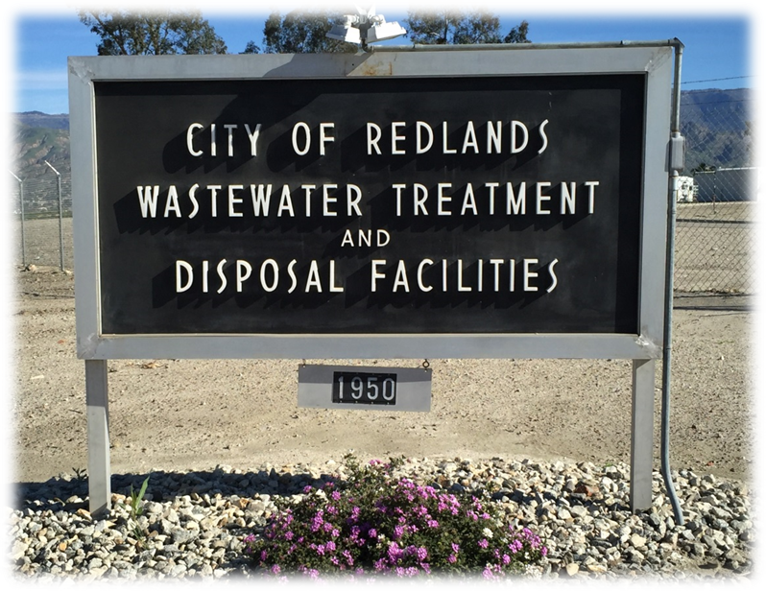
Municipal Utilities & Engineering Department
Status of the City of Redlands Wastewater Treatment Plant (WWTP)

Slide 2
Discussion
History of WWTP
Current Operations Status
Condition Assessment
WWTP Options
Next Steps

Slide 3
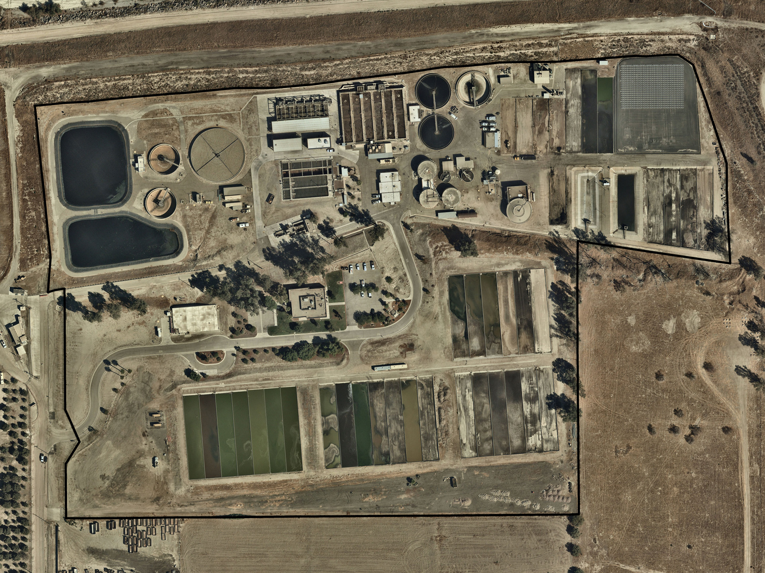
WWTP – Present day
Notes:
- Current site east of California Street Landfill and south of Santa Ana River

Slide 4
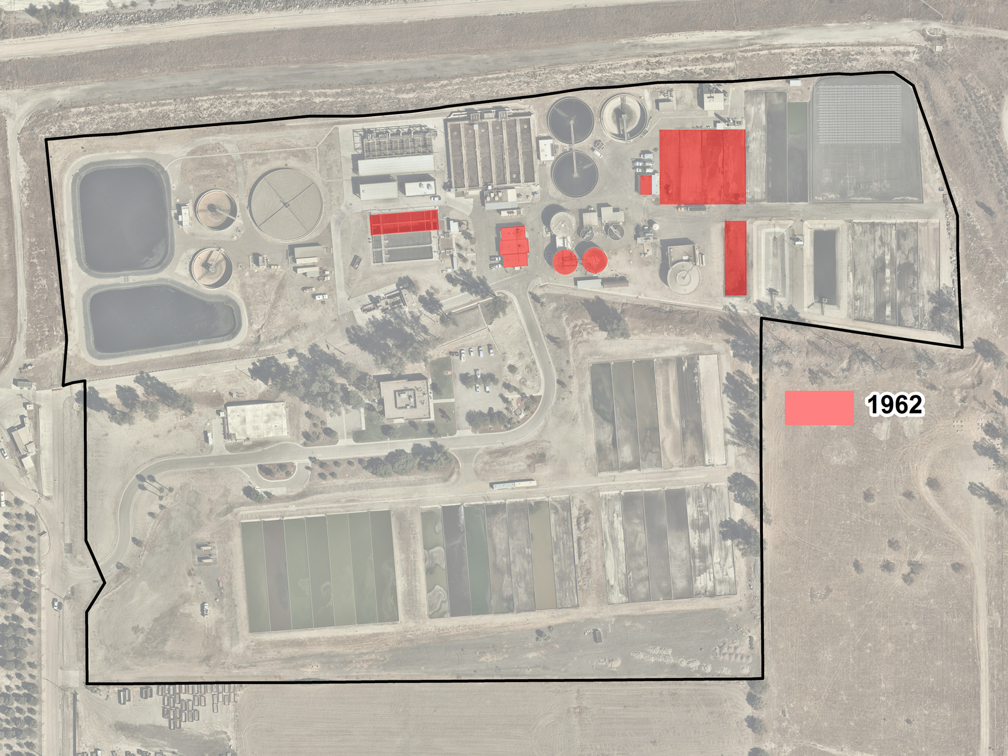
Secondary Treatment
Sludge Beds
Primary & Secondary Digester
Primary Clarifiers
Inlet Structure
Capacity of 5.0 MGD
Discharge to Santa Ana River
1962 - Original WWTP constructed
Notes:
- Capacity of 5 MGD and discharging to Santa Ana River

Slide 5
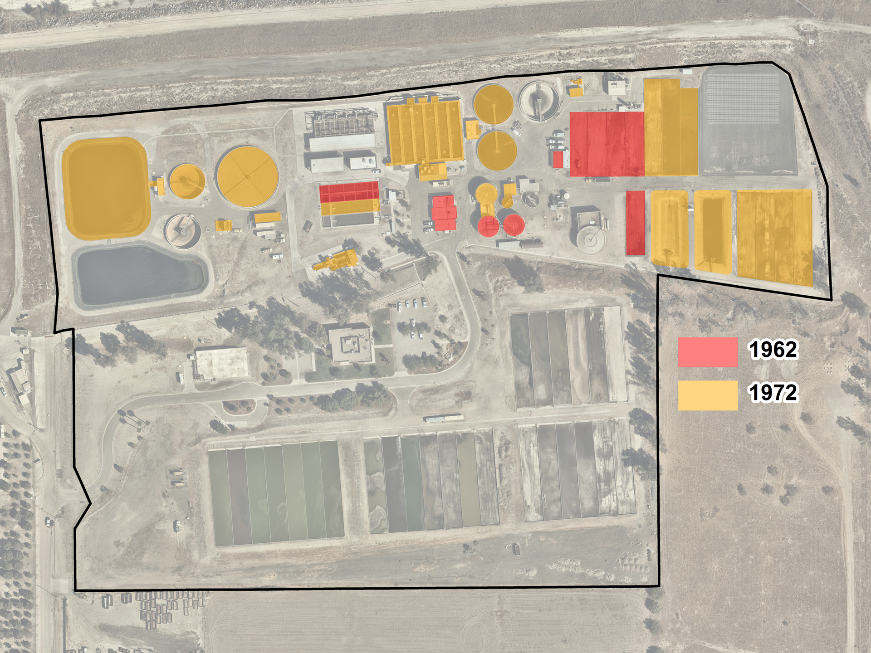
Storage Pond
Aeration Basins
Secondary Clarifier
Trickling Filter
Sludge Beds
Primary Clarifier
Primary Digester & Sludge Thickening
Headworks
Capacity of 6.0 MGD
Discharge to Percolation Ponds east of Alabama
1972 – Expansion & modification
Notes:
Clean Water Act 1972 led to increased discharge requirements
6 MGD and discharging to spreading grounds

Slide 6
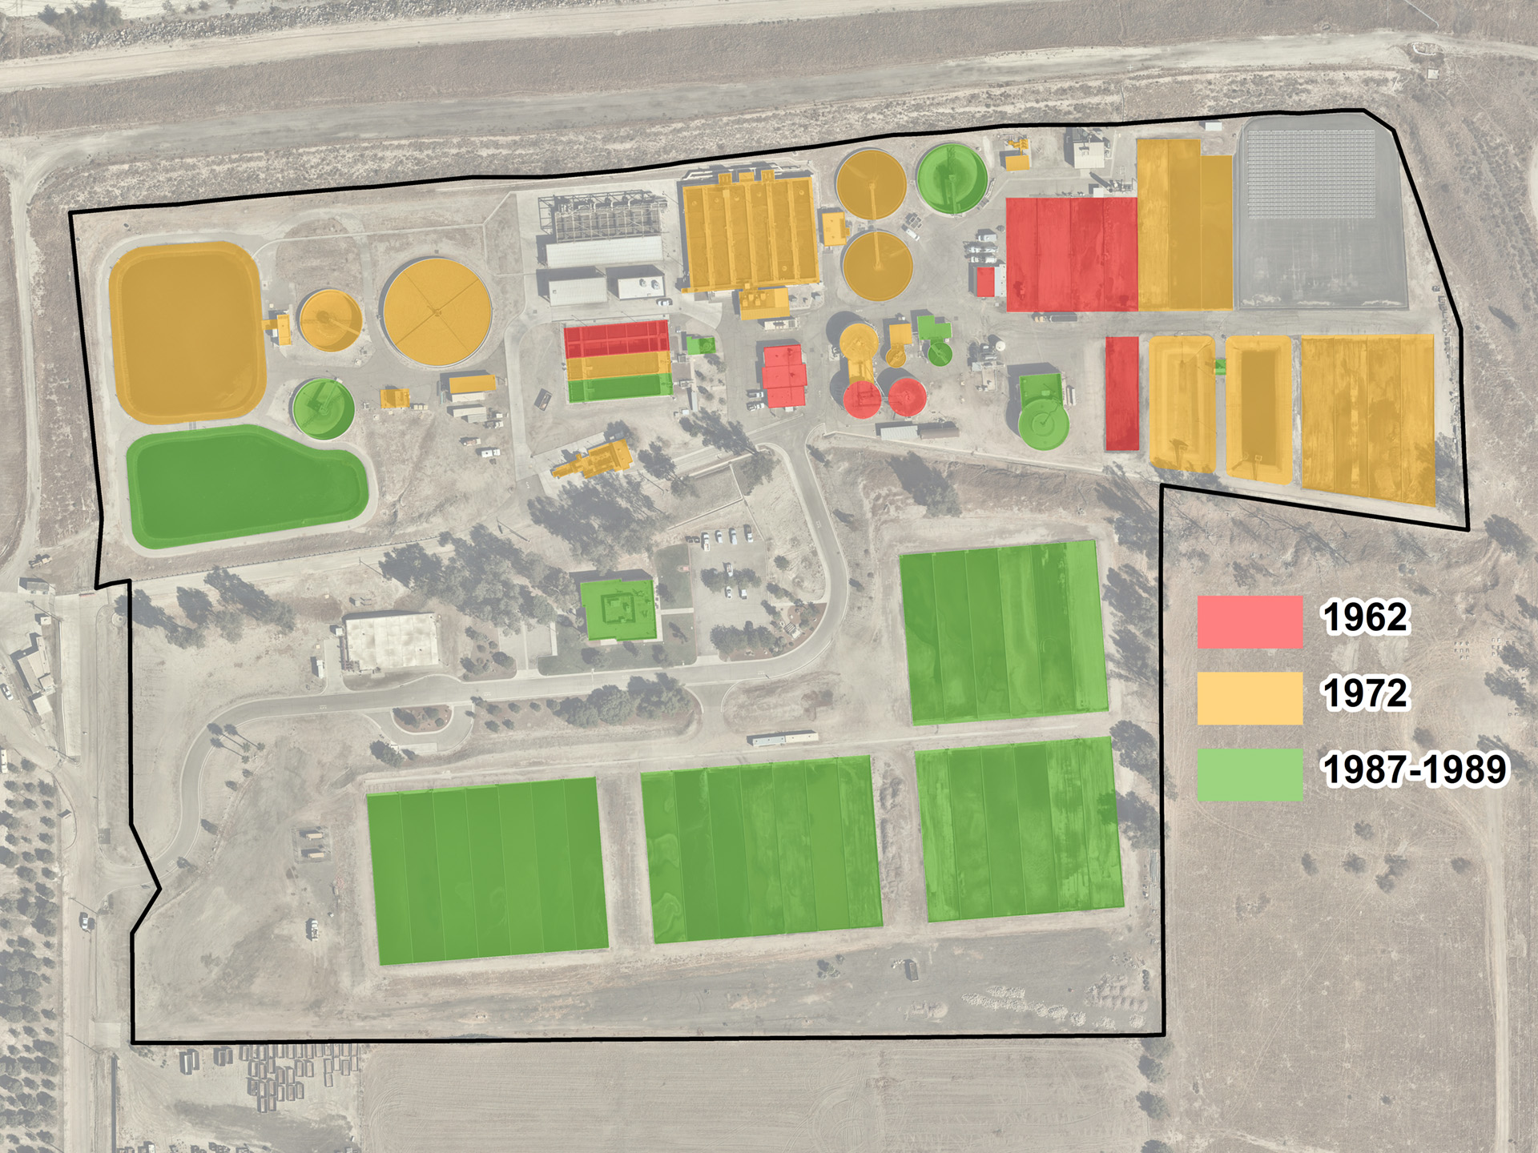
Secondary Clarifier
Storage Pond
TF Clarifier
Primary Digester
Primary Clarifier
Admin. Bldg.
Sludge Beds
Capacity of 9.0 MGD
1987 – 1989 Expansions for growth
Notes:
- Numerous expansions for growth between 1987 and 1989

Slide 7
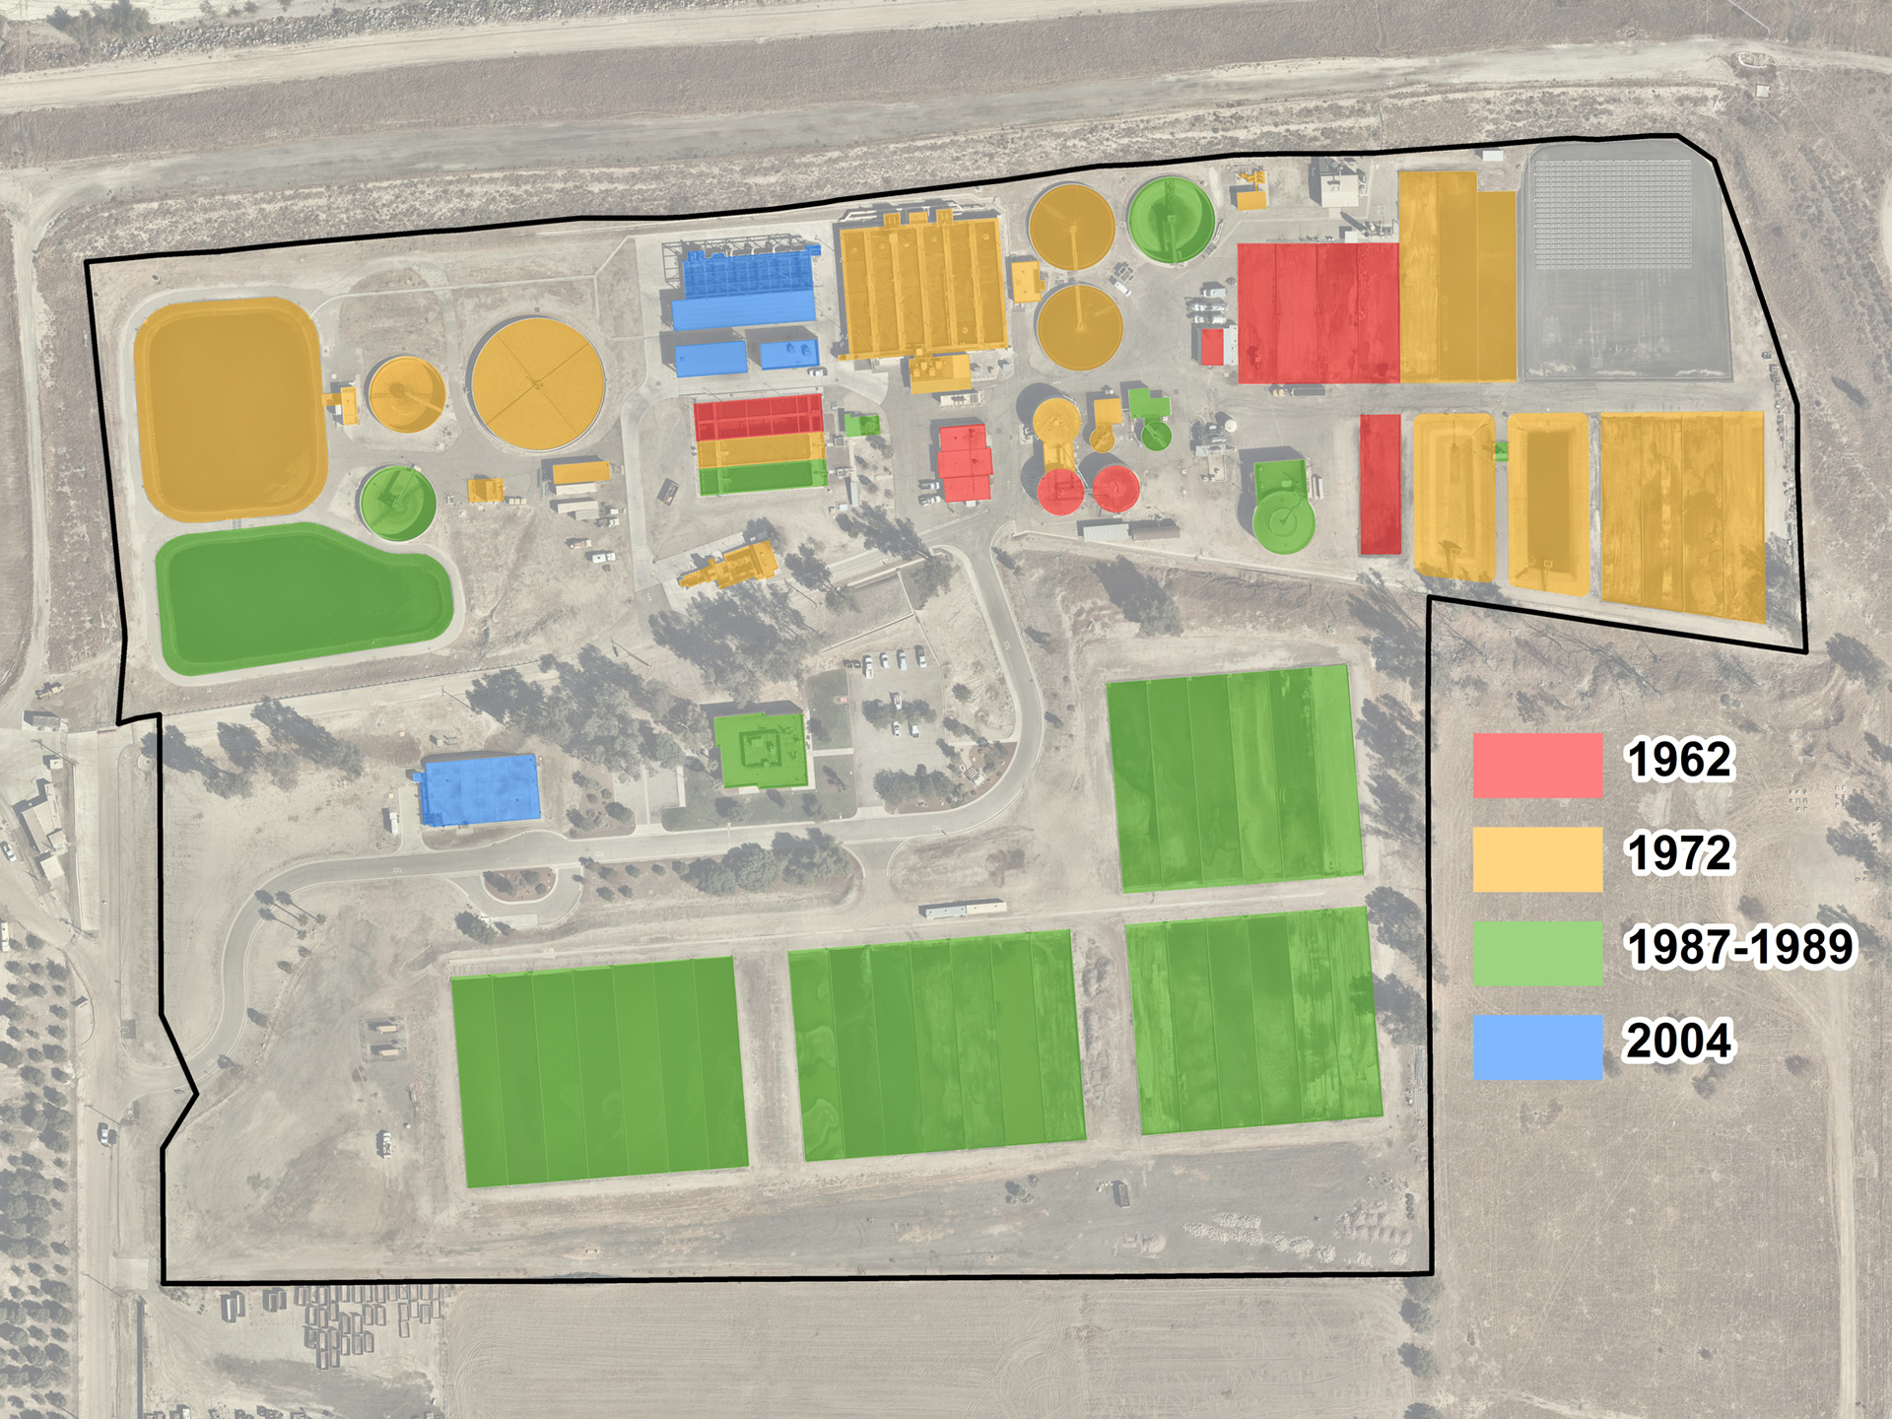
Aeration Basin Modification
Membrane Bioreactor
Chlorine Contact Tank
Capacity of 9.5 MGD
6.0 MGD recycled water
3.5 MGD conventional
2004 – Recycled water system
Notes:
Effort to produce recycled water in response to drought conditions
Produce recycled water for Mountain View Power Plant
Engine and transmission analogy

Slide 8
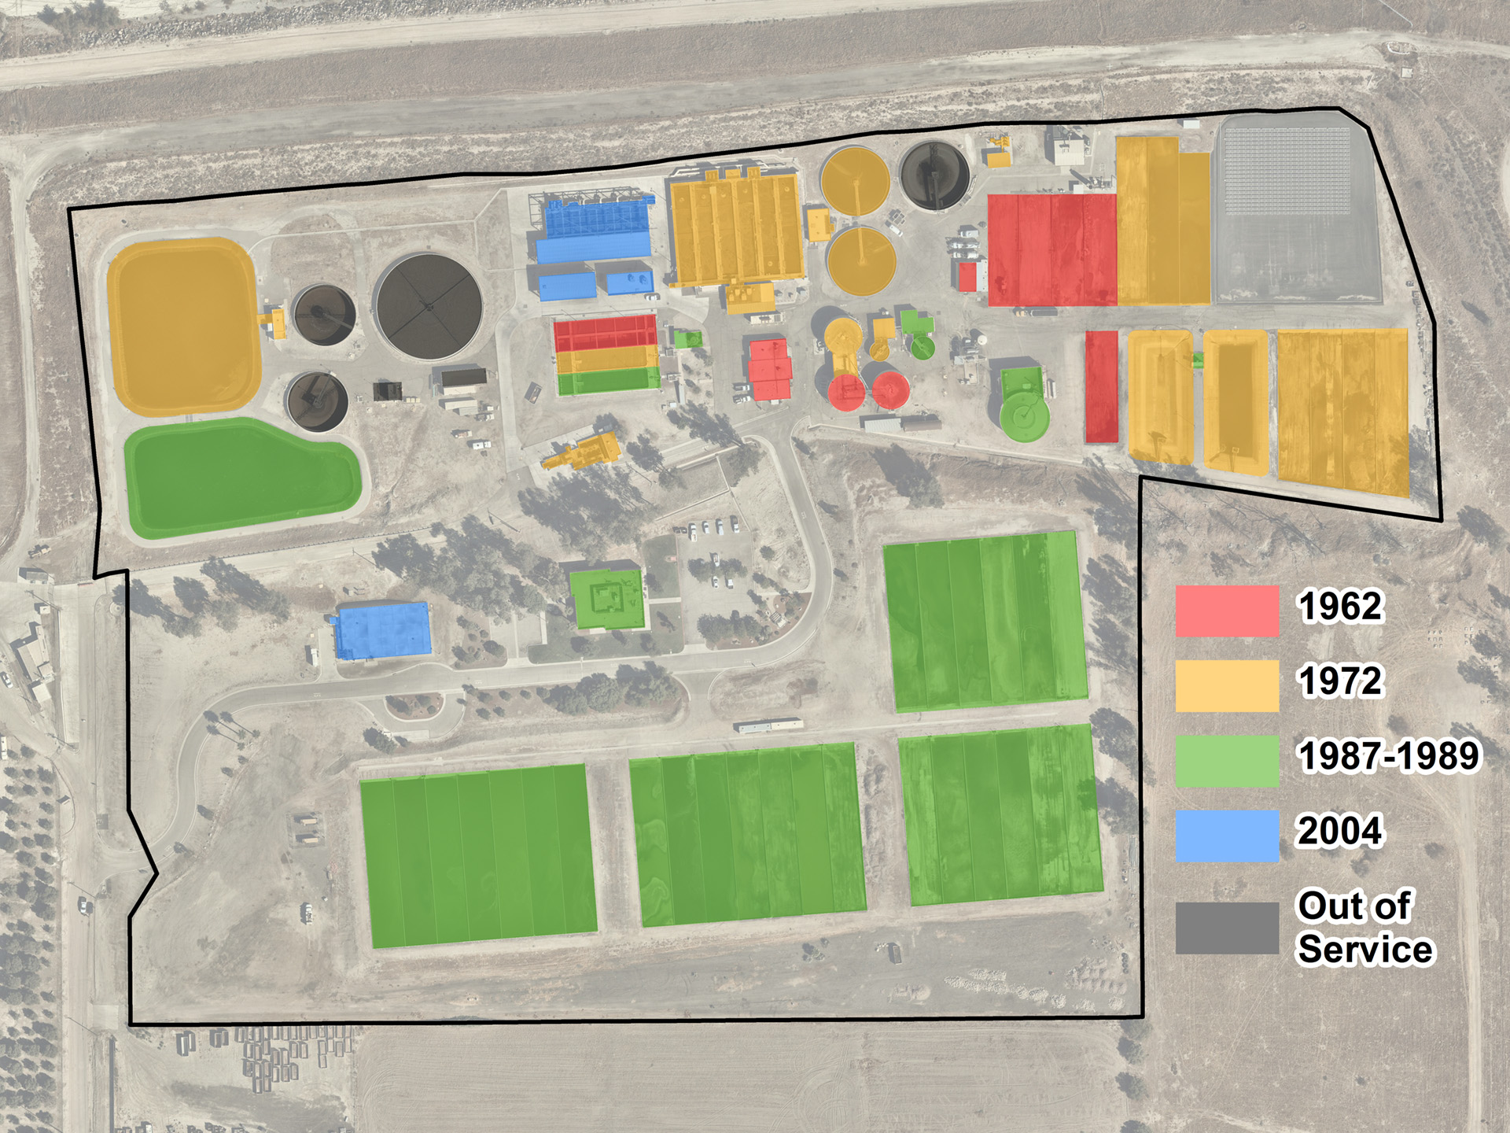
WWTP – Current facility status
Notes:
Trickling filter from 1972 and secondary clarifier from 1988 out of service due to evolving technology and reduced flows to conventional treatment side
Current plant is a composition of 57 years of infrastructure

Slide 9
Current Operations Status
Current average flows of 5.5 MGD
Flows are split between MBR (recycled water) and conventional (treated water to be recharged)
Current permitted capacity projected to be adequate until at least 2040, based upon anticipated growth and continued conservation

Slide 10
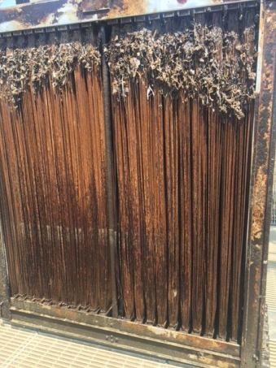
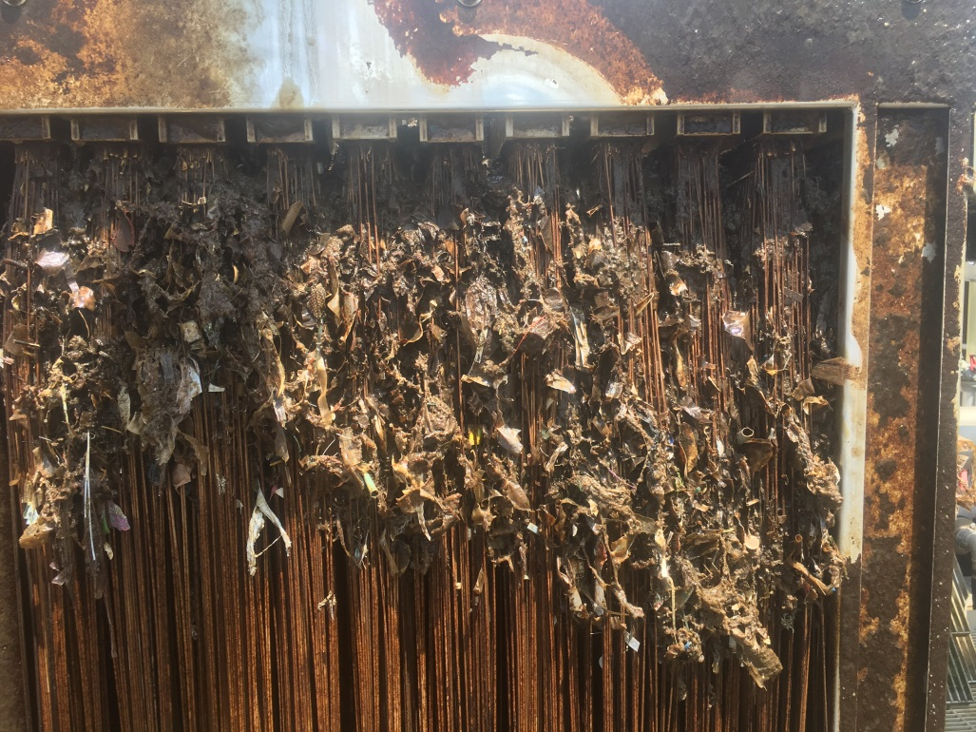
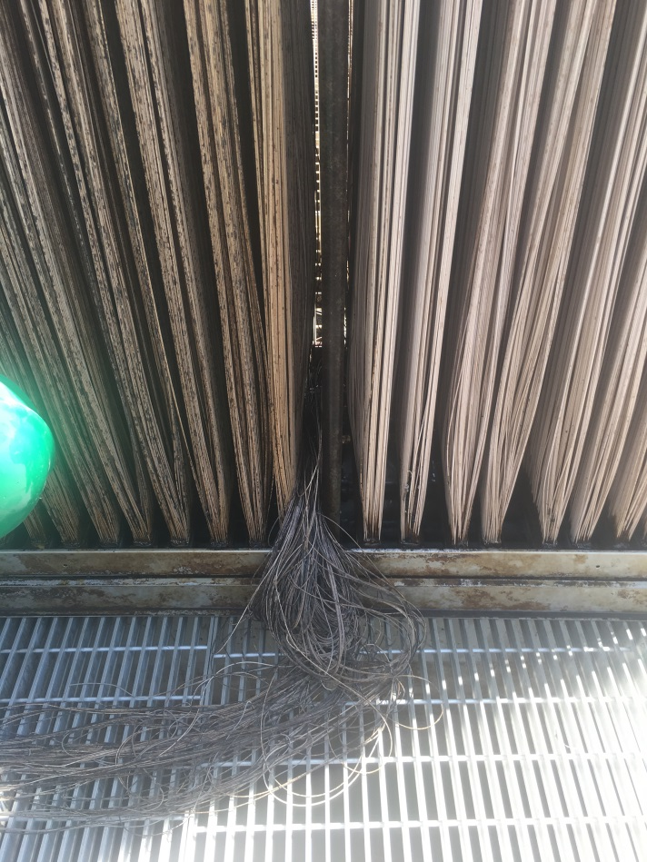
Operations Challenges
Membrane Bioreactor (MBR)
MBR completed in 2004
Typical lifespan = 8 years
Notes:
Large amount of buildup due to lack of fine screens
Strands falling out of module
Engine of the car

Slide 11
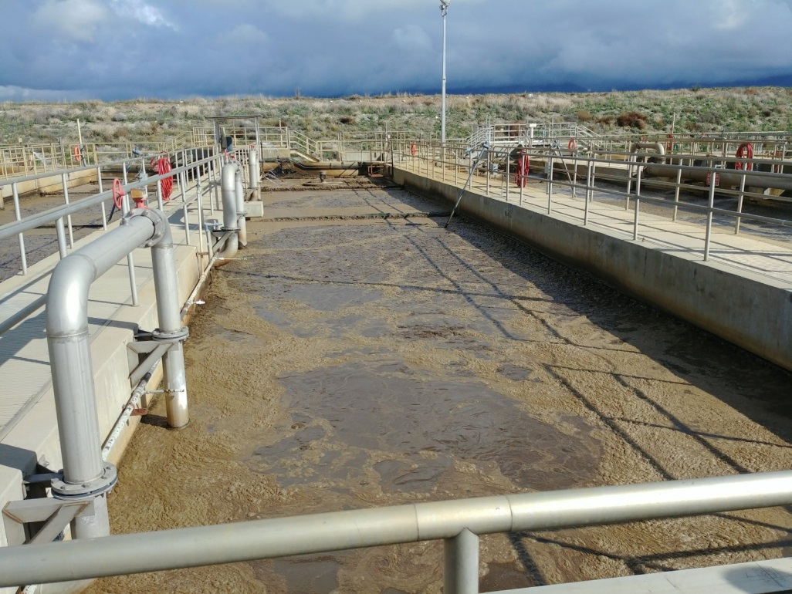
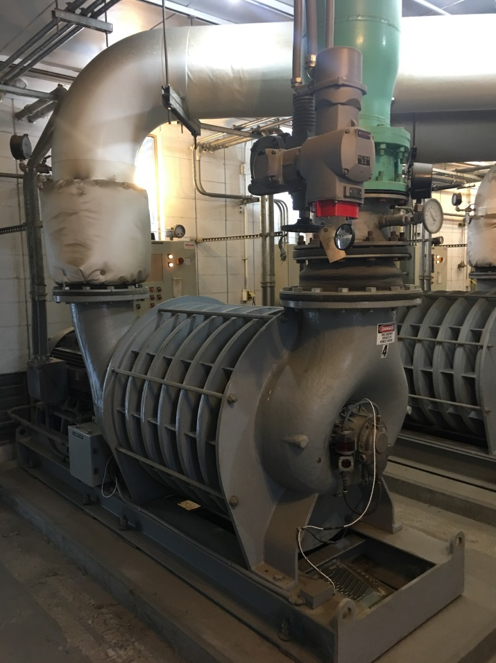
Operations Challenges
Aeration Basins
Constructed in 1972, modified in 2004
Cannot isolate basins or maintain air diffusers
Notes:
- Transmission of the car

Slide 12
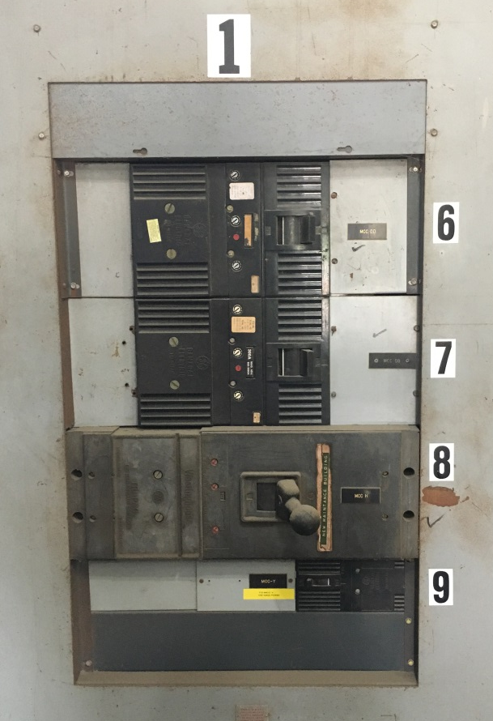
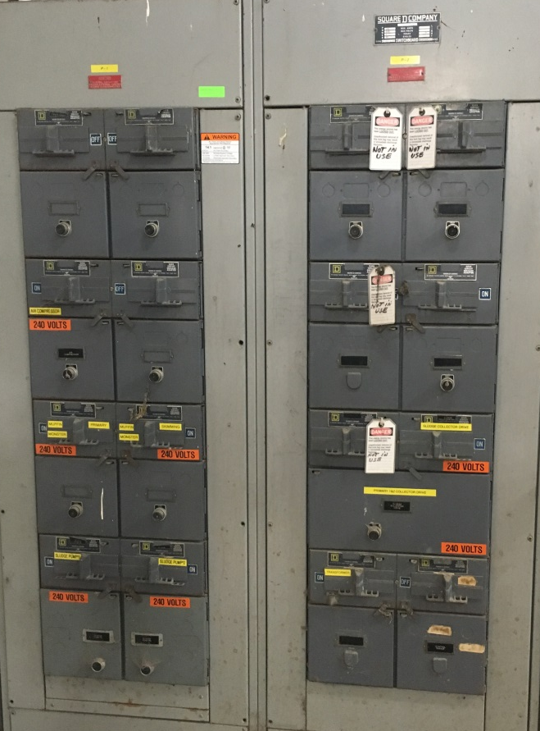
Operations Challenges
Electrical Infrastructure
Aging electrical system, some equipment from 1962
Critical electrical service infrastructure installed in 1972
Update to current code requirements
1972 Switchboard
1962 Motor Control Center

Slide 13
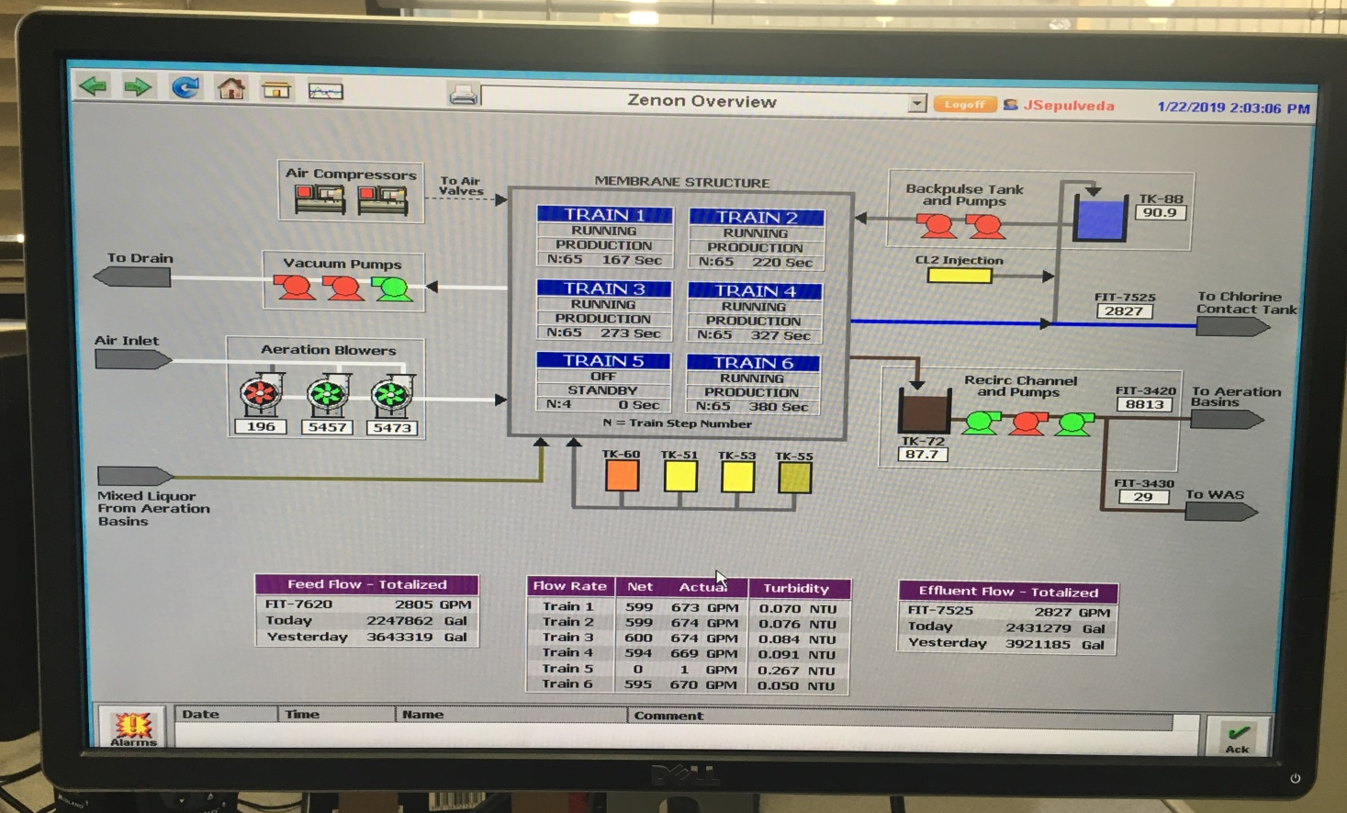
Operations Challenges
Supervisory Control and Data Acquisition
Many of the WWTP key processes are not connected to the SCADA system and are controlled manually

Slide 14
Operations Challenges
Efficiency
Energy
Limited operational flexibility to treat evolving incoming flow
Water conservation
Industry discharge
Technology improvements to increase treatment efficiency
Reliability
Provide redundancy of critical processes
Limited parts for repairs leading to abandonment or increased costs and delay for repair

Slide 15
Operations Challenges
Additional challenges:
Evaluate in kind replacement for MBR
Constant reactive state from operations staff
Difficult to maintain regulatory compliance with potential failures of critical infrastructure
Pending implementation of best management practices from regulatory agencies
Potential to impede future economic development
Notes:
- In order to continue operations or current WWTP

Slide 16
Condition Assessment
How do we address the challenges?
Request for Proposals (RFP) in early 2018
Purpose:
Independent assessment of facilities
Roadmap for future

Slide 17
RFP Scope
Task 1 – Field Assessment
Task 2 – Project Report/Implementation Plan
Task 3 – Engineering Design Services
Task 4 – Construction Management Services

Slide 18
RFP Outreach
Outreach effort
Pre-proposal conference
12 engineering consultants attended
2 hour tour and visual assessment
Follow-up visits
Staff provided 6 independent tours
Over 200 hours spent assessing plant

Slide 19
RFP Process
Received 4 proposals
Evaluation Process
Reviewed proposals
Completed interviews
Developed scope of work based on:
Visual Assessment;
Standard industry practices;
Recommendation of engineering professionals; and
Discussion with field operations staff.

Slide 20
Options for WWTP
Rehabilitation of existing WWTP
Phased improvements
Comprehensive improvements
Construction of a new WWTP

Slide 21
Rehabilitation of existing WWTP
Membrane Bioreactor System
Install MBR system
Install fine screens
Replace/upgrade piping and back wash system
Aeration Basins
Modification and rehabilitation
Install high speed turbo blowers
Replace piping, valves and other appurtenances
Headworks Upgrades
Washer/compactor for screenings and grit
Solids Handling System Upgrades
Miscellaneous Facility Improvements
Improvement life of 20-25 years
Note: Electrical, control & site improvements included within each item above.
Notes:
Recommended rehabilitation items identified through assessment process

Slide 22
Phased Improvement Projects
Total cost (Phase 1 & 2) = $43.8 Million
Phase 1 (2-3 years) total cost = $32.8 Million
Design = $2.8 Million
Construction = $30 Million
Membrane Bioreactor System (MBR) = $12.6 Million
Aeration Basins = $14.7 Million
10% Contingency = $2.7 Million
Phase 2 (7-8 years) total cost = $11 Million
Construction = $11 Million
Headworks = $6.3 Million
Solids Handling System = $2.5 Million
Additional Facility Improvements = $1.2 Million
10% Contingency = $1 Million
Notes:
Implement recommended improvements in a phased approach with Phase 1 in 2-3 years and Phase 2 in the future, potentially 7-8 years for completion.

Slide 23
Comprehensive Improvement Project
Total cost = $41.3 Million
Design = $2.8 Million
Construction = $38.5 Million
Membrane Bioreactor System (MBR) = $12.6 Million
Aeration Basins = $14.7 Million
Headworks = $4.7 Million
Solids Handling System Upgrades = $2 Million
Additional Facility Improvements = $1 Million
10% Contingency = $3.5 Million
Same design and construction scope as phased improvement project but completed in 2-3 years instead of 7-8 years
Notes:
Implement same construction scope as phased approach but in a 2-3 timeframe
Same design scope for a phased or comprehensive approach

Slide 24
Construction of a new WWTP
Total cost = $100 Million
Design = $8 Million
Construction = $92 Million ($84 Million + 10% Contingency)
New treatment facilities adjacent to existing WWTP with same capacity
Improvement life of 30-35 years
Anticipate completion timeline of 4-6 years
Notes:
- Cost based on recently awarded WWTP in Highland and Beaumont

Slide 25
Summary
 | Cost ($ Million) | Project Time (years) | Lifespan (years)
Phased | $43.8 | 7-8 | 20-25
Comprehensive | $41.3 | 2-3 | 20-25
New | $100 | 4-6 | 30-35

Slide 26
Next Steps
Award design contract
Conduct Peer Evaluation
Engage services of financial consultant to develop a revenue program and explore potential financing options
Solicit applications for formation of Utilities Advisory Committee (UAC)
Notes:
Scope developed to complete either a phased or comprehensive rehabilitation project
Construction phasing can be decided during detailed design and once financial analysis is completed

Slide 27
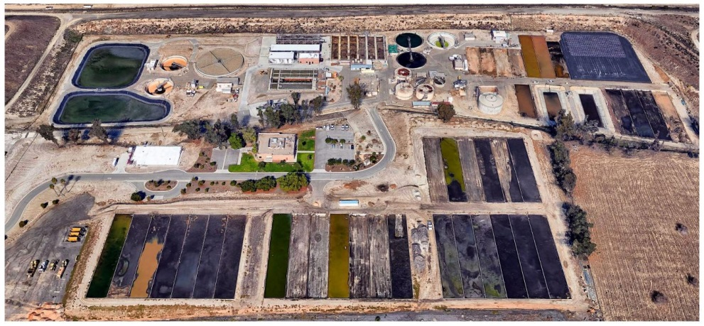
Questions

